Slide 1
Software Engineering
Module 2
Software Project Management
Dr. Shai Koenig
Open University
Department of Computer Science

Slide 2
Software Project Management
What is software project management ?
Scope management
Work management
  Software estimation techniques *
Human Resources management
Risk management *
Acquisition management *
Quality and Process management

Slide 3
Software project management
Concerned with activities involved in ensuring
that software is delivered on time and within budget and in accordance with the requirements of the organizations developing and procuring the software.

Slide 4

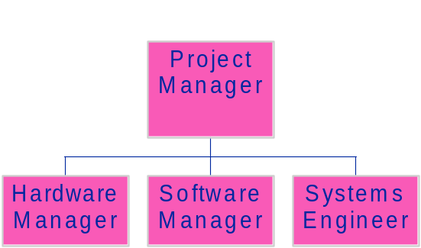
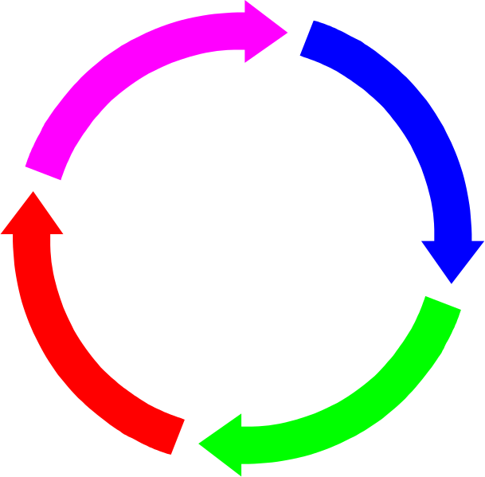




Project Management
Organization Plan
Work
Plan
Controlling
Planning
WORK
PLAN
Process
Plan
Project
Scope
Reporting
Tracking

Slide 5
Software project management
Concerned with activities involved in ensuring
that software is delivered on time and within budget and in accordance with the requirements of the organizations developing and procuring the software.
Management Areas
  Scope management
  Work management
  Quality and Process management
  People management
  Risk management
  Acquisition management
Management Activities
  Planning
  Tracking
  Controlling
  Reporting

Slide 6
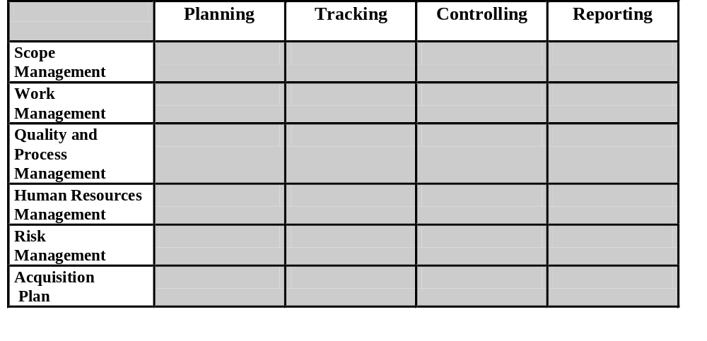
Project Management

Slide 7
Why is management important?
Software engineering is an economic activity
and therefore is subject to economic,
non-technical constraints
Well-managed projects sometimes fail, but badly
managed projects inevitably fail
The objective of this module is to introduce
management concepts, processes and activities rather than teach you to be managers.
You can only learn to manage by managing.

Slide 8
Management commonalities
Many of these activities are not specific to software
management
Many techniques of engineering project
management are equally applicable to software
project management
Technically complex engineering systems tend
to suffer from the same problems as software
systems
Differences from general project management include
  Estimation techniques
  Process and quality management
  Measurements

Slide 9
Software Project Management
Scope Management
Scope Planning
Scope Tracking and Controlling

Slide 10
Scope Management
Scope management is primarily concerned with defining and controlling what is and is not included in the project.
Scope management ensures that
The project builds what has to be built
The project builds only what has to be built
    The project does not build something that does not have to be built
The project is not late due to accepting too much work

Slide 11
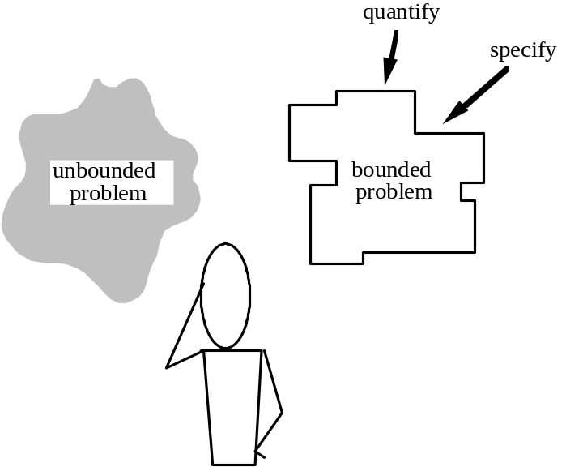


Scope Management - Planning
Requirements
Elicitation
Business
Needs
Statement
of
Requirements
Project
Scoping
Requirements
Specification

Slide 12
Scope Management - Planning
Context diagram
External
Entity
a
b
Project/System/Software
External
Entity
c
d
External
Entity

Slide 13
Scope Management - Planning
Collect and list candidate features
Analyze features
  importance, effort, stability
Classify - priority
  mandatory, essential, recommended, suggested
Sort by priority
Decide on schedule and budget
Accept requirements until they exhaust schedule and budget
Verify business sense

Slide 14
Scope Management - Planning
Scope management involves balancing requirements with a large number of other “business” factors
  Schedule
  Cost
  Risk
  Market segment
  Pricing, sales and profits
  Return on investment
  …

Slide 15
Define Project Scope - Planning
Context diagram
External
Entity
Features
…
…
…
a
b
Project/System/Software
External
Entity
c
d
External
Entity

Slide 16
Controlling Project Scope
As soon as the scope has been fixed,
pressures build up to change the scope

Slide 17
Controlling Project Scope
As soon as the scope has been fixed,
pressures build up to change the scope
Changes to project scope result from a number of factors
Feature enhancements
New features
Internal improvements
Adaptation to new operating environments
Defects

Slide 18
Controlling Project Scope
Changes must be managed using a change life-cycle
Request
Change
Changes to project scope result from a number of factors
Feature enhancements
New features
Internal improvements
Adaptation to new operating environments
Defects

Slide 19
Controlling Project Scope
Changes must be managed using a change life-cycle
Request
Change
Changes to project scope result from a number of factors
Feature enhancements
New features
Internal improvements
Adaptation to new operating environments
Defects
technical impact
budget impact
schedule impact
business impact
Analyze
Change

Slide 20
Controlling Project Scope
Changes must be managed using a change life-cycle
Request
Change
Changes to project scope result from a number of factors
Feature enhancements
New features
Internal improvements
Adaptation to new operating environments
Defects
technical impact
budget impact
schedule impact
business impact
Analyze
Change
Decide
Change
accept
reject
postpone

Slide 21
Controlling Project Scope
Changes must be managed using a change life-cycle
Request
Change
Changes to project scope result from a number of factors
Feature enhancements
New features
Internal improvements
Adaptation to new operating environments
Defects
technical impact
budget impact
schedule impact
business impact
Analyze
Change
Decide
Change
accept
reject
postpone
accept
Implement
Change

Slide 22
Controlling Project Scope - Problems
Scope decisions are often
  made by “osmosis”
  dominated by political factors
    Battle ground between sales, marketing and R&D
  made without performing adequate impact analysis
Few companies actually have a well defined process
  responsibility is unclear
  criteria are not defined
  tools are lacking
Many companies do not adequately understand their market’s dynamics

Slide 23
Work Management
Software Project Management
Work Planning
Work Tracking
Work Controlling
Work Reporting

Slide 24
Work Planning
develop a work breakdown structure
analyze precedences and construct an activity network
allocate resources to activities
develop a schedule

Slide 25
Terminology
Activities [tasks] are the units of work in a project.
Activity decomposition - an activity can be recursively decomposed into subactivities
Atomic [lowest level] activity – an activity which is not further decomposed, performed by one or a few people in a short time, with well-defined inputs and outputs
Milestone - the end-point of a set of related activities that represents a significant achievement
Deliverables are project results delivered to “customers”

Slide 26
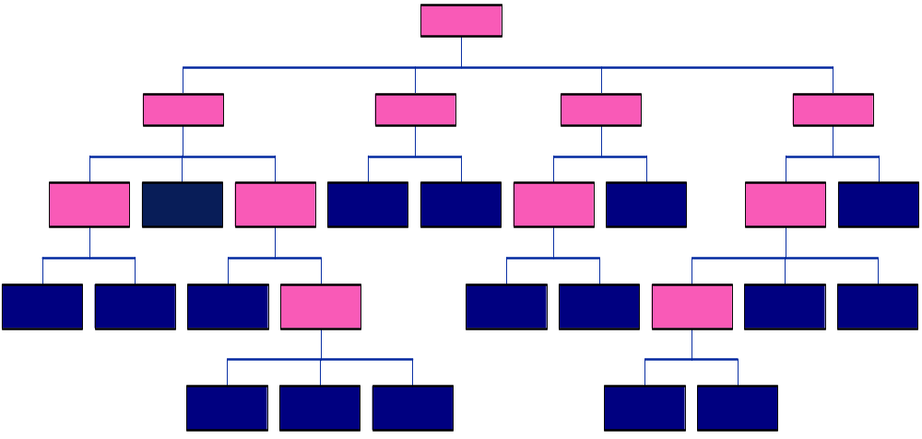
Create a WBS

Slide 27
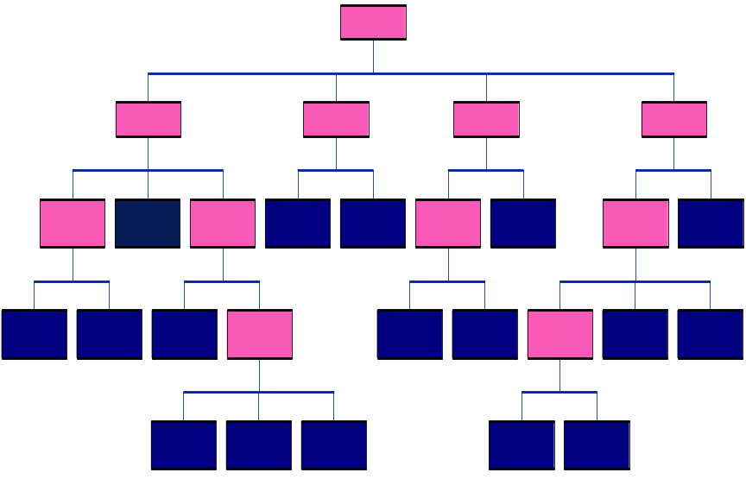
WBS provides a basis for
cost estimation
activity scheduling
resource allocation
project organization
project tracking and control

Slide 28
Developing a WBS [work breakdown structure]
a WBS should be as complete as possible
activities should be defined to produce tangible outputs for management to judge progress
level of detail will increase as project progresses

Slide 29
WBS Decomposition Criteria
lifecycle increments
lifecycle phases
organization
product components
system functions
usually a combination of the above

Slide 30
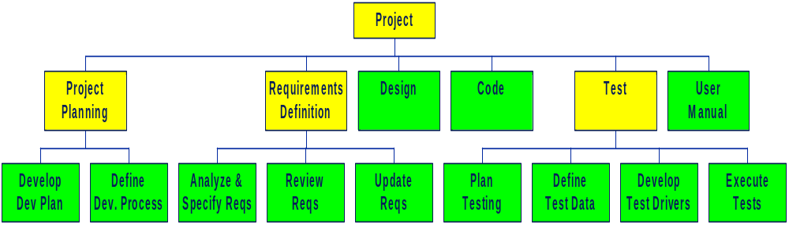
WBS

Slide 31
Estimate resources for each activity
human resources [effort]
duration [calendar time]
development environment
  equipment
  software resources [i.e., tools]
  work space
training
travel and living expenses

Slide 32
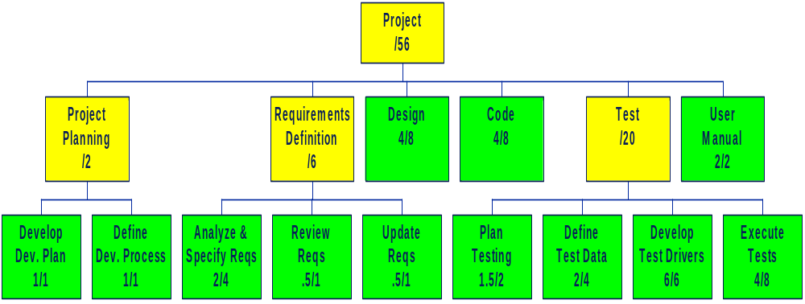
Estimate resources for each activity
duration [in months] / effort [in man-months]

Slide 33
Work Planning
develop a work breakdown structure
analyze precedences and construct an activity network
allocate resources to activities
develop a schedule

Slide 34
Create Activity Precedence Network
User
Manual
2
Reqs
A/S
Review
Reqs
Update
Reqs
Design
Code
2
.5
.5
4
4
Dev
Plan
1
Finish
Test
Data
Start
2
Plan
Tests
1.5
Execute
Tests
Dev
Process
4
1
6
Test
Drivers

Slide 35
Activity networks
An acyclic directed graph representing the lowest level WBS activities and the precedence relationships between these activities
  Activity on the Node
  Activity on the Arc [Arrow, Link]
activity precedence network, PERT chart, task network
Types of precedence relationships
  finish to start
  start to start
  finish to finish

Slide 36
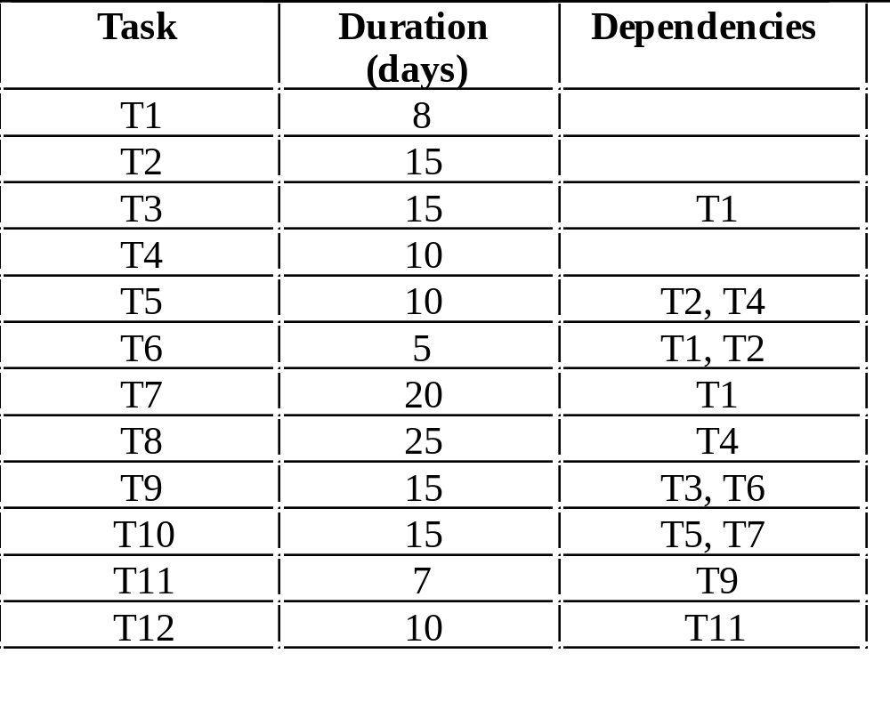
Task duration and dependency table

Slide 37
Critical path analysis
What is the minimum time that it will take to complete the project ?
What activities are “critical” to earliest completion ?
What is the earliest time that an activity can start ?

Slide 38
Critical path analysis
What is the minimum time that it will take to complete the project ?
What activities are “critical” to earliest completion ?
What is the earliest time that an activity can start ?
User
Manual
2
Reqs
A/S
Review
Reqs
Update
Reqs
Design
Code
2
.5
.5
4
4
Dev
Plan
1
Finish
Test
Data
Start
2
Plan
Tests
1.5
Execute
Tests
Dev
Process
4
1
6
Test
Drivers

Slide 39
Calculate Earliest Start/Finish
User
Manual
2
Reqs
A/S
Review
Reqs
Update
Reqs
Design
Code
[0,1]
2
.5
.5
4
4
Dev
Plan
[0,0]
1
Finish
Test
Data
Start
2
[0,1]
Plan
Tests
1.5
Execute
Tests
Dev
Process
4
1
6
Test
Drivers
early-start[Node] := maximum {early-finish[X] | all X predecessor-of Node}
early-finish[Node] := early-start[Node] + duration[Node]

Slide 40
Calculate Earliest Start/Finish
User
Manual
2
[1,3]
[3,3.5]
Reqs
A/S
Review
Reqs
Update
Reqs
Design
Code
[0,1]
2
.5
.5
4
4
Dev
Plan
[0,0]
1
Finish
Test
Data
Start
2
[0,1]
Plan
Tests
1.5
Execute
Tests
Dev
Process
4
1
6
Test
Drivers
early-start[Node] := maximum {early-finish[X] | all X predecessor-of Node}
early-finish[Node] := early-start[Node] + duration[Node]

Slide 41
Calculate Earliest Start/Finish
User
Manual
2
[1,3]
[3,3.5]
[3.5,4]
Reqs
A/S
Review
Reqs
Update
Reqs
Design
Code
[0,1]
2
.5
.5
4
4
Dev
Plan
[0,0]
1
Finish
Test
Data
[3.5,5]
2
Start
[0,1]
Plan
Tests
1.5
Execute
Tests
Dev
Process
4
1
6
Test
Drivers
early-start[Node] := maximum {early-finish[X] | all X predecessor-of Node}
early-finish[Node] := early-start[Node] + duration[Node]

Slide 42
Calculate Earliest Start/Finish
User
Manual
2
[1,3]
[3,3.5]
[3.5,4]
[4,8]
Reqs
A/S
Review
Reqs
Update
Reqs
Design
Code
[0,1]
2
.5
.5
4
4
Dev
Plan
[5,7]
[0,0]
1
Finish
Test
Data
[3.5,5]
2
Start
[0,1]
Plan
Tests
1.5
Execute
Tests
Dev
Process
[5,11]
4
1
6
Test
Drivers
early-start[Node] := maximum {early-finish[X] | all X predecessor-of Node}
early-finish[Node] := early-start[Node] + duration[Node]

Slide 43
Calculate Earliest Start/Finish
[8,10]
User
Manual
2
[1,3]
[3,3.5]
[3.5,4]
[4,8]
[8,12]
Reqs
A/S
Review
Reqs
Update
Reqs
Design
Code
[0,1]
2
.5
.5
4
4
Dev
Plan
[16,16]
[5,7]
[0,0]
1
Finish
Test
Data
[3.5,5]
2
[12,16]
Start
[0,1]
Plan
Tests
1.5
Execute
Tests
Dev
Process
[5,11]
4
1
6
Test
Drivers
early-start[Node] := maximum {early-finish[X] | all X predecessor-of Node}
early-finish[Node] := early-start[Node] + duration[Node]

Slide 44
Early Start/Finish Algorithm
Given a directed acyclic graph <Nodes, Preds, StartNode> where
  Nodes is a set of nodes,
  Preds is a predecessor relation on Nodes
  StartNode is the graph’s unique node with no predecessors
and a function
  Duration: Nodes → nonnegative numbers
Compute the functions
  EarlyStart : Nodes → nonnegative numbers
  EarlyFnish : Nodes → nonnegative numbers
as follows
/* Initialization */
set N = StartNode ;
set EarlyStart[N] = 0 ;
set EarlyFinish[N] = 0 ;
while [“there exists unlabeled nodes”] do
set N = “some unlabeled node whose predecessors are all labeled” ;
set EarlyStart[N] = maximum { EarlyFinish[X] | X “is a predecessor of” N }
set EarlyFinish[N] = EarlyStart[N] + Duration[N] ;
endwhile

Slide 45
Identify the Critical Paths
[8,10]
User
Manual
2
[1,3]
[3,3.5]
[3.5,4]
[4,8]
[8,12]
Reqs
A/S
Review
Reqs
Update
Reqs
Design
Code
[0,1]
2
.5
.5
4
4
Dev
Plan
[16,16]
[5,7]
[0,0]
1
Finish
Test
Data
[3.5,5]
2
[12,16]
Start
[0,1]
Plan
Tests
1.5
Execute
Tests
Dev
Process
[5,11]
4
1
6
Test
Drivers
The critical paths of an activity network are the paths from node Start to node Finish with the maximum length. Note that there may be more than one critical path in a network. A critical activity is any activity on a critical path.

Slide 46
Determining Late Start & Slack Times
What is the latest time that an activity can start without delaying the overall project finish time ?
  late start
  late finish
How much can the duration of an activity be extended without delaying the overall project finish time ?
  slack time [float time]

Slide 47
Determining Late Start & Slack Times
[8,10]
User
Manual
2
[1,3]
[3,3.5]
[3.5,4]
[4,8]
[8,12]
[14,16]
Reqs
A/S
Review
Reqs
Update
Reqs
Design
Code
[0,1]
2
.5
.5
4
4
Dev
Plan
[16,16]
[5,7]
[0,0]
1
Finish
Test
Data
[3.5,5]
2
[12,16]
Start
[16,16]
[0,1]
Plan
Tests
1.5
Execute
Tests
Dev
Process
[5,11]
4
1
6
[12,16]
Test
Drivers
late-finish[Node] := minimum {late-start[X] | X successor-of Node}
late-start[Node] := late-finish[Node] - duration[Node]
Slack[Node] := late-start[Node] - early-start[Node]

Slide 48
Determining Late Start & Slack Times
[8,10]
User
Manual
2
[1,3]
[3,3.5]
[3.5,4]
[4,8]
[8,12]
[14,16]
Reqs
A/S
Review
Reqs
Update
Reqs
Design
Code
[0,1]
2
.5
.5
4
4
[8,12]
Dev
Plan
[16,16]
[5,7]
[0,0]
1
Finish
Test
Data
[3.5,5]
2
[12,16]
Start
[16,16]
[0,1]
Plan
Tests
1.5
[10,12]
Execute
Tests
Dev
Process
[5,11]
4
1
6
[12,16]
Test
Drivers
[6,12]
late-finish[Node] := minimum {late-start[X] | X successor-of Node}
late-start[Node] := late-finish[Node] - duration[Node]
Slack[Node] := late-start[Node] - early-start[Node]

Slide 49
Determining Late Start & Slack Times
[8,10]
User
Manual
2
[1,3]
[3,3.5]
[3.5,4]
[4,8]
[8,12]
[14,16]
Reqs
A/S
Review
Reqs
Update
Reqs
Design
Code
[0,1]
2
.5
.5
4
4
[4,8]
[8,12]
Dev
Plan
[16,16]
[5,7]
[0,0]
1
Finish
Test
Data
[3.5,5]
2
[12,16]
Start
[16,16]
[0,1]
Plan
Tests
1.5
[10,12]
Execute
Tests
Dev
Process
[5,11]
4
1
[4.5,6]
6
[12,16]
Test
Drivers
[6,12]
late-finish[Node] := minimum {late-start[X] | X successor-of Node}
late-start[Node] := late-finish[Node] - duration[Node]
Slack[Node] := late-start[Node] - early-start[Node]

Slide 50
Determining Late Start/Finish & Slack Times
[8,10]
User
Manual
2
[1,3]
[3,3.5]
[3.5,4]
[4,8]
[8,12]
[14,16]
Reqs
A/S
Review
Reqs
Update
Reqs
Design
Code
[0,1]
2
.5
.5
4
4
[1,3]
[3,3.5]
[3.5,4]
[4,8]
[8,12]
Dev
Plan
[16,16]
[5,7]
[0,0]
1
Finish
[0,1]
Test
Data
[3.5,5]
2
[12,16]
Start
[16,16]
[0,1]
Plan
Tests
1.5
[10,12]
Execute
Tests
[0,0]
Dev
Process
[5,11]
4
1
[4.5,6]
6
[12,16]
Test
Drivers
[0,1]
[6,12]
late-finish[Node] := minimum {late-start[X] | X successor-of Node}
late-start[Node] := late-finish[Node] - duration[Node]
Slack[Node] := late-start[Node] - early-start[Node]

Slide 51
Basic concepts of critical path analysis
length of a path
critical path
critical activity
critical path algorithm
  minimal completion time for project
  critical activities
  earliest start time per activity
  earliest finish time per activity
  slack time per activity

Slide 52
Implications
Extending the duration of a critical activity by time X, extends the duration of the project by time X.
If only a single critical path exists, we can shorten the overall project duration by shortening the duration of a critical path activity
An activity’s slack time can be used to
  delay its start time
  lengthen its duration
  both

Slide 53
Work Planning
develop a work breakdown structure
analyze precedences and construct an activity network
allocate resources to activities
develop a schedule

Slide 54
Allocate Resources to Activities
Decide who is needed for each activity
  what percent of his/her time
  what amount of effort
Decide what equipment is needed for each activity
Recalculate activity duration [start and finish]
What we now have is an ideal plan assuming all resources are available when needed !
However -
  not all resources are available when needed !
  we may have overallocated !
  mythical man-month phenomenon !

Slide 55
Work Planning
develop a work breakdown structure
analyze precedences and construct an activity network
allocate resources to activities
develop a schedule

Slide 56
Develop a Schedule
Inputs
WBS
activity network
resource constraints
  allocate absolute dates
  allocate personnel
  allocate other needed
  resources
Outputs
for each lowest level activity
  start date
  completion date
  resource allocation
for each resource allocated, a list of its assigned activities and their
  start date
  completion dates
  % allocation

Slide 57
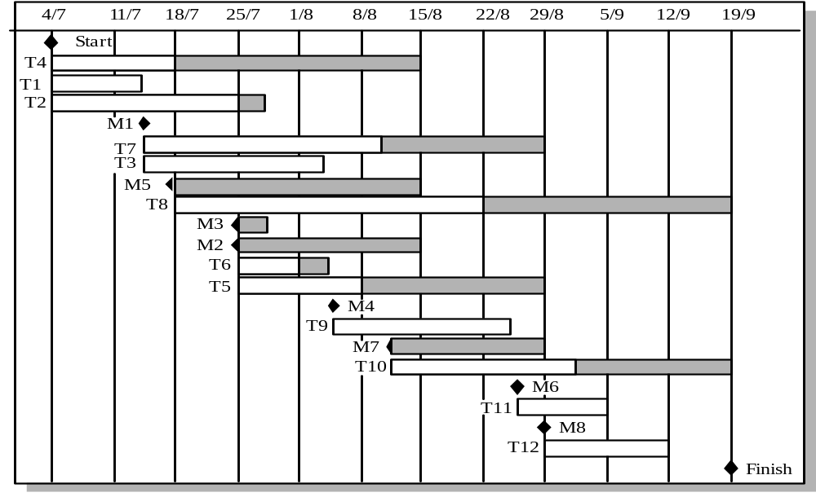
Gantt Charts [bar chart, activity timeline]

Slide 58
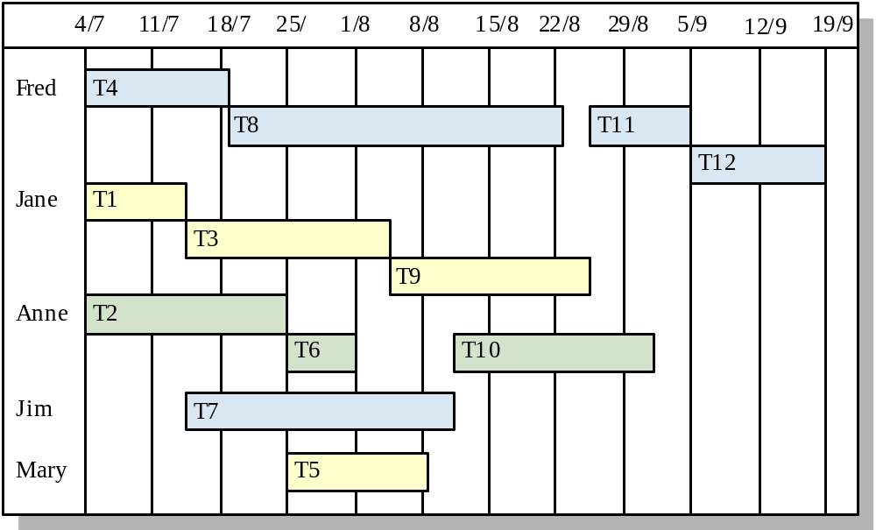
Staff allocation

Slide 59
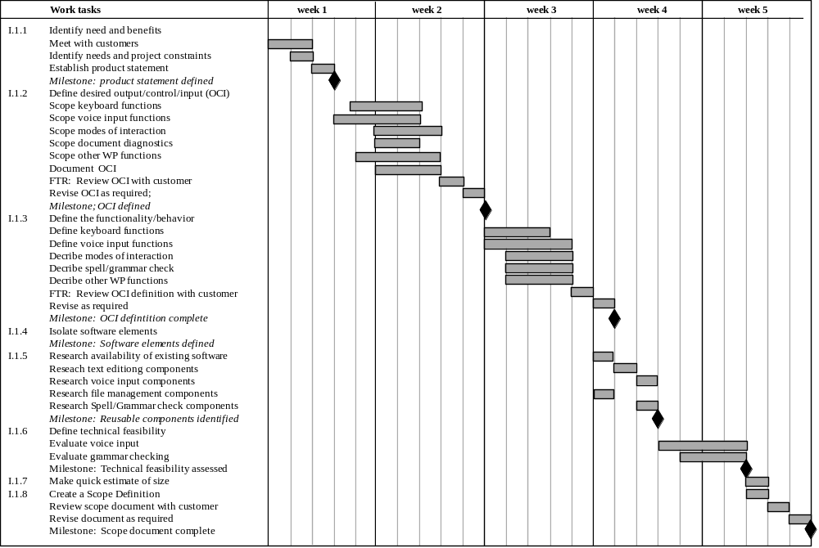
Use Automated Tools to Derive a Timeline Chart

Slide 60
Gantt [Bar] charts and activity networks
Graphical notations used to illustrate the project schedule
Show project breakdown into tasks.
Activity network charts show task dependencies and the the critical path
Bar charts show schedule against calendar time

Slide 61
Develop a Schedule
Resource Levelling - The process of adjusting a schedule to fit within established resource limits
  Generally it is best to work on resources in descending order of worst overload
  The process is iterative, since levelling one resource may overload other resources
  For a given overloaded resource
    move offending tasks within their float [by adjusting the delay value]
    increase the duration of offending tasks within their float by reducing the resource assignments to maintain total units but at lower levels
    substitute resources with equivalent or greater capability for the overloaded resource
    delay jobs past their float if none of the above strategies work. This will increase the duration of the project

Slide 62
Advanced scheduling concepts
shared resource database
calendars
  organization
  personal
scheduling modes
  asap - generally used
  alap - only when necessary
date constraints
  start/finish
    on
    no earlier than
    no later than
negative slack
  amount of time by which a target date is missed
precedence relationships
  finish - start
  start - start
  finish - finish
hammock [span] tasks
lag time, lead time, delay

Slide 63
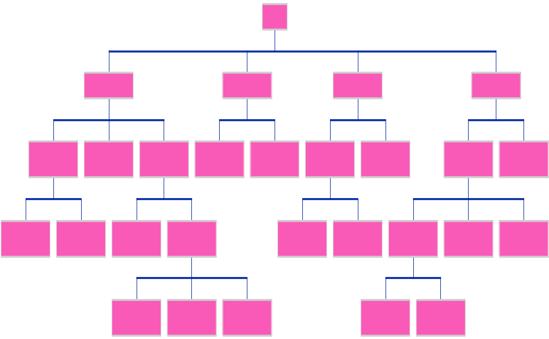
Work Planning Overview

Slide 64
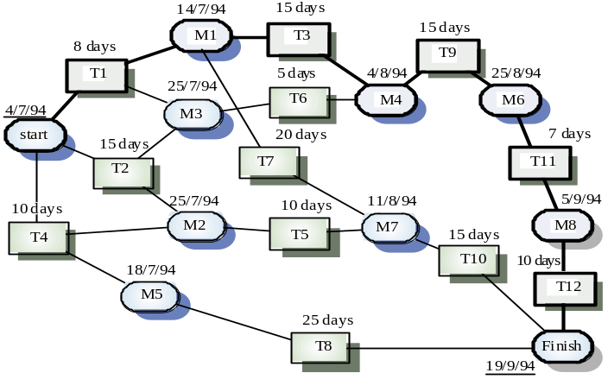
Work Planning Overview

Slide 65
Work Planning Overview

Slide 66
Work Planning Overview

Slide 67
Work Planning Problems
It is easy to forget project activities
It is difficult to estimate activity effort and duration
Productivity is not proportional to the number of people working on a task
Adding people to a late project makes it later because of communication overheads
The unexpected always happens. Always allow contingency in planning

Slide 68
Work Plan Tracking
The work tracking activity involves
  recording actual work status and
  comparing the status with the work plans
What to track ?
  progress [percent of work completed]
  effort [hours/days invested in work]
Record progress and effort expended
How to track
  “corridor” management
  progress reports
  project status meetings
  quantify
Look for trends
Use the data to predict the project’s ability to achieve its objectives

Slide 69
Work Plan Controlling
when the work plan and actual progress and/or actual budget diverge re-planning is required
  reduce scope [functionality, quality characteristis,...]
  revise schedule
  resolve resource conflicts
  recruit [this will have the opposite effect in the short term]
  request more funding

Slide 70



Work Plan Reporting
create reports to communicate project status to
Clients
Management
Staff

Slide 71
Human Resources Management
Managing people working as individuals and in groups
Software Project Management
Organizational planning
Staffing
Team building
Training and professional development
Work Environment

Slide 72
Organization Planning -
Organizational Roles
System Engineering Group
specifying system requirements
system design
specifying hw/sw interfaces
inter-disciplinary coordination
System/Software Test Group
planning independent sw/system testing
performing independent sw/system testing
SW Engineering Group
software development
  reqs, design,
  coding, unit testing
software maintenance
SW Engineering Process Group
definition of sw processses
maintenance of sw processses
improvement of sw processses
SW Configuration Management Group
planning the SCM activities
establishing the SCM environment
implementing SCM activities
supporting the use of the SCM environment
SW Quality Assurance Group
plan quality assurance activities
implement quality assurance activities
assist in measuring sw quality

Slide 73
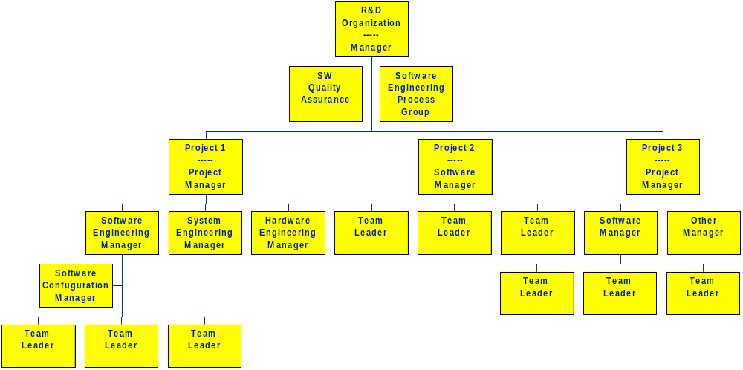
Organization Planning -
Line Organization
Issues
1. Where are support functions [sqa, scm, sepg] best placed ?
2. How do we ensure independence and involvement of QA staff ?
3. Dotted line reporting ?
4. Distribution vs. centralization ?

Slide 74
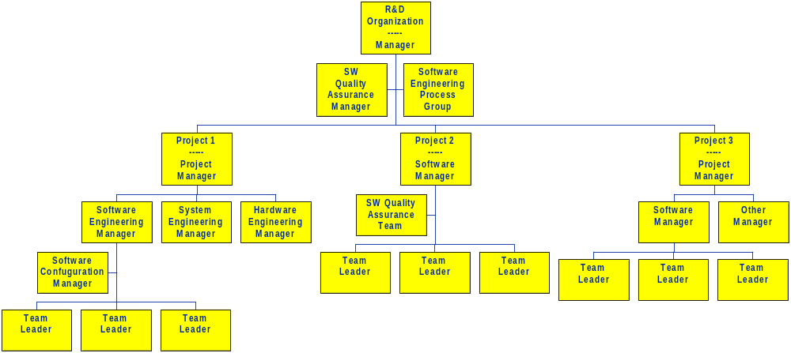
Organization Planning -
Line Organization

Slide 75
Organization Planning -
Matrix Organization
 | Project Mgmt | Systems Eng | HW Eng | Software Eng | SQA | SCM | …
Project 1
Project 2
Project 3
Project 4
Project 5
…

Slide 76

Project Staffing
Choosing and placing people to work on a project is a major managerial responsibility
Appointment decisions are usually based on
  information provided by the candidate
  information gained in the course of interviews
  recommendations from other people
  psychological or aptitude tests
Staffing decisions are a [the?] critical factor in project success !

Slide 77
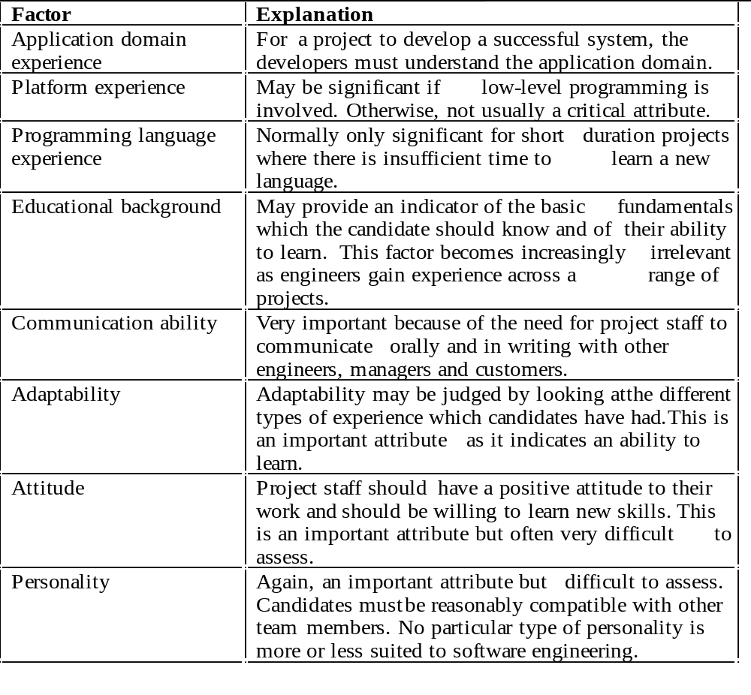
Project Staffing -
Staff Selection and Placement Factors

Slide 78
Team Building
Most software engineering is a team activity
  Most software projects cannot be completed by one person working alone
Team interaction is a key determinant of group
performance
Teams should have the “right” balance of
  technical skills
  experience
  personalities
However, flexibility in team composition is often limited
  Managers must do the best they can with available people

Slide 79
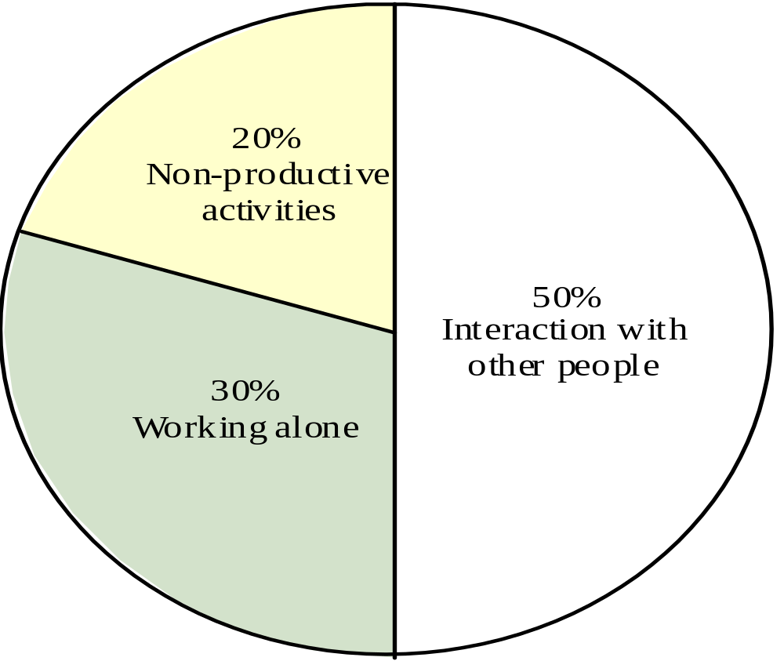
Team Building -
Time distribution of software developers

Slide 80

Team Building -
Team Building Factors
Factors which affect successful team working
composition
cohesion
leadership
communication
organization

Slide 81
Team Building -
Team Composition
Teams composed of members who share the
same motivation can be problematic
  Task-oriented - everyone wants to do their own thing
  Self-oriented - everyone wants to be the boss
  Interaction-oriented - too much chatting, not enough work
An effective group has a balance of all types
Can be difficult to achieve because most
engineers are task-oriented
Need for all members to be involved in decisions which affect the group

Slide 82
Team Building -
Team Leadership
Leadership depends on respect not titular
status
The technical leader and the administrative leader may not be the same person
Democratic leadership is more effective than
autocratic leadership
A career path based on technical competence
should be supported

Slide 83
Team Building -
Team Cohesiveness
In a cohesive group, members consider the group to be more important than any individual in it
Advantages of a cohesive group are:
  Group quality standards can be developed
  Team members learn from each other and get to know each other’s work
  Egoless programming where members strive to improve each other’s programs can be practised

Slide 84
Team Building -
Team Communications
Effective intra-team communication is essential
Factors in intra-team communication include
  Status of group members
    Note - higher status members tend to dominate conversations
    Uninhibited communication should be encouraged
  Personalities in groups
    Too many people of the same personality type can be a problem
  Sexual composition of group
    People prefer mixed-gender groups, mixed-sex groups tend to communicate better
  Communication channels
    Open, “point-to-point” communication lines
    Communciations channelled through a central coordinator tend to be ineffective

Slide 85
Team Building -
Team Organization
Software engineering group sizes should be relatively small (< 8 members)
Break big projects down into multiple smaller projects
Small teams [of mature, experienced staff] may be organised in an informal, democratic way
Chief programmer teams [Baker-1972] try to make the most effective use of skills and experience

Slide 86

Professional Development
People want to develop their skills and expand their knowledge
This is
  an individual need
  a project need
  an organizational need
Education and training
  Define needs
  Plan training activities
  Implement and track

Slide 87
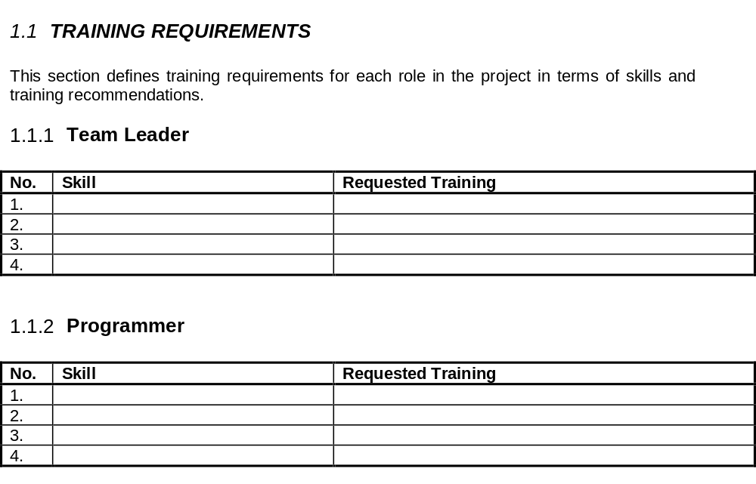
Professional Development -
Define training needs

Slide 88
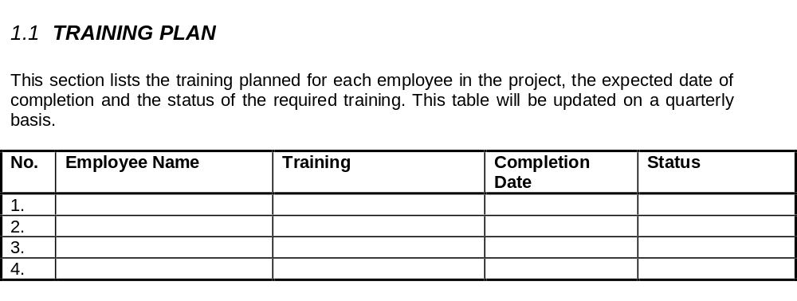
Professional Development -
Plan and monitor training

Slide 89
Work Environments
Physical workplace provision has an important
effect on individual productivity and satisfaction
  Comfort
  Privacy
  Facilities
Health and safety considerations must be taken
into account
  Lighting
  Heating
  Furniture

Slide 90
Work Environments -
Environmental factors
Privacy - each engineer requires an area for
uninterrupted work
Outside awareness - people prefer to work in
natural light
Personalization - individuals adopt different
working practices and like to organize their
environment in different ways

Slide 91
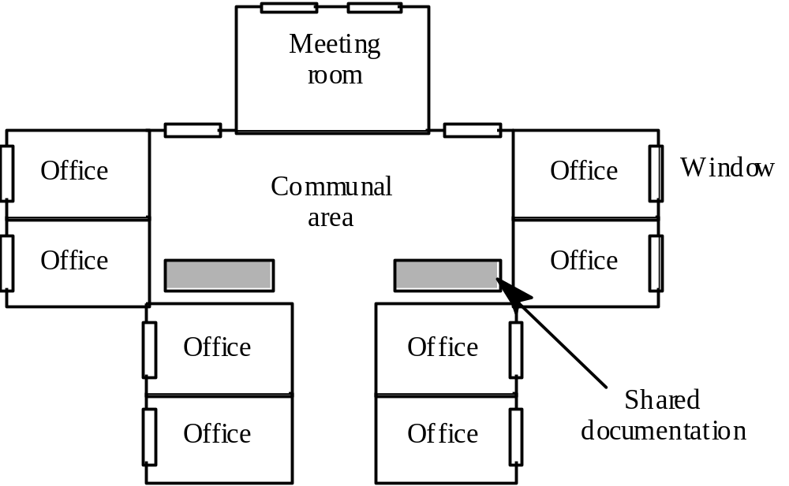
Work Environments -
Office organization
coffee
corner

Slide 92
Work Environments -
Equipment provisioning
Computers
  Each engineer should have a personal workstation with access to software which is needed for his/her job
Telecommunications
  telephone, fax, e-mail, networking facilities
  Good telecomm. facilities can drastically costs
Information / Knowledge Management
  common information - databases, file servers
  groupware - systems such as Lotus Notes facilitate information sharing

Slide 93
Key points
Managers must have some understanding of people if they are to be effective
Staff selection and assignment factors include education, domain experience, adaptability and personality
Software development groups should be small and cohesive
Intra-group communications are a significant factor in the success of the group
The working environment [both technical and physical] has a significant effect on productivity

Slide 94
Note
We have described scope management in terms of
  what is and is not to be done as part of the project
We have described work management in terms of
  what [detailed work breakdown,...]
  when [duration, effort, schedule,...]
  who [effort, resource allocation,...]
We have discussed people management
  both at the individual level and at the team level
We have not described how the work is to be done
  process
  quality
This is the subject of the next module -
Quality and Process Management

